Slide 1
Final Project: Second Part
Stephen Ross

Slide 2
Entity Relationship Design- Car Rental Data
Store
Car
StoreID
Town
State
Density
Lot_Size
CarID
Make
Model
Model Year
Rate Level
Sold At
Kind of Car
Sales
Txt_ID
StoreID
CarID
PlanID
RateID
Revenue
Plan
How long you keep the car and discounts associated.
Rate
Kind of Rate
Plan ID
Duration
% Discount
Discount Type
Rate Id
Daily
Weekly Monthly
Stephen Ross
ISTM 6290
Notes:
Explain the relationships between each

Slide 3
Store Table
Unique ID
(Primary Key)
Attributes
Instances

Slide 4
Cars Table

Slide 5
Plan Table

Slide 6
Rate Table

Slide 7
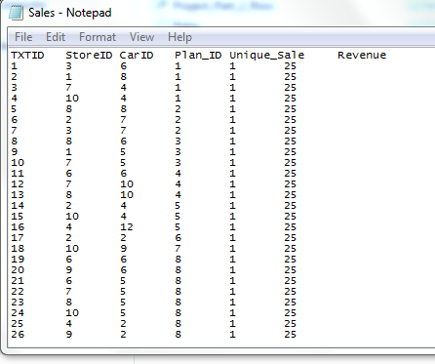
Sales Table

Slide 8
Create Table Statements Using SQL Commands
Create table Stores(
StoreID int not null,
Town text,
State text,
Density text,
Lot_Size int);
Create table Cars(
CarID int not null,
Make text,
Model text,
Model_Year text,
Rate_Level int);
Create table Plan(
PlanID int not null,
Discount_Type text,
Duration text,
Discount_Percentage int);
Create table Sales(
TXTID int not null,
StoreID int,
CarID int,
PlanID int,
RateID int);
Create table Rates(
RateID int not null,
Daily int,
Weekly int,
Monthly int);

